Slide 1




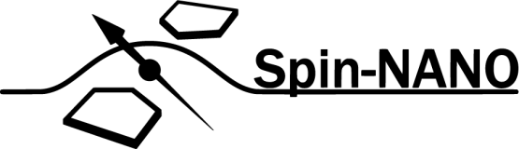
A Multi-Node Quantum Network with Defects in Diamond
Ph.D. Proposal - Matteo Pompili

Slide 2
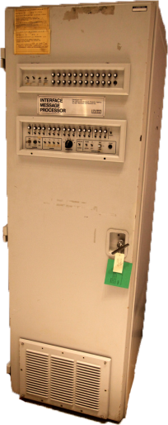

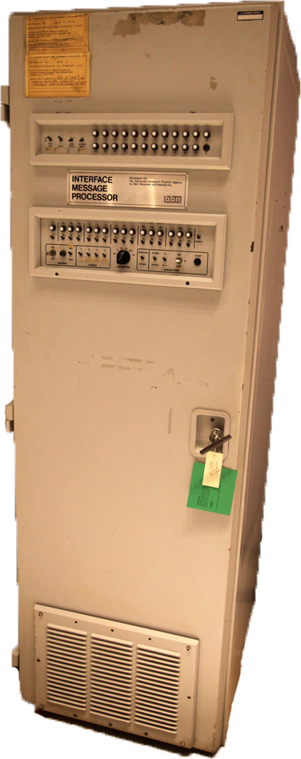

What is a (Quantum) Network?

Slide 3
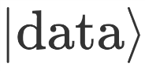
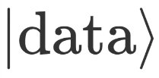
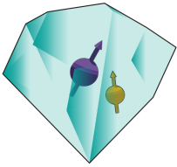


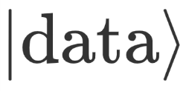



What is a (Quantum) Network?

Slide 4




What is a (Quantum) Network?
Known applications:
Quantum Key Distribution (QKD)
Blind quantum computation
Distributed quantum computation
Clock Synchronization
Leader election
…

Slide 5
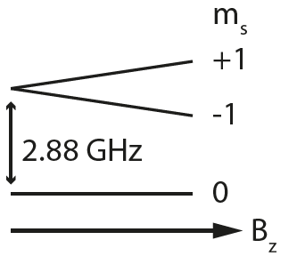
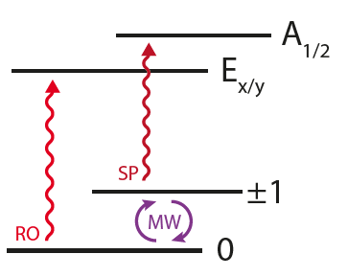
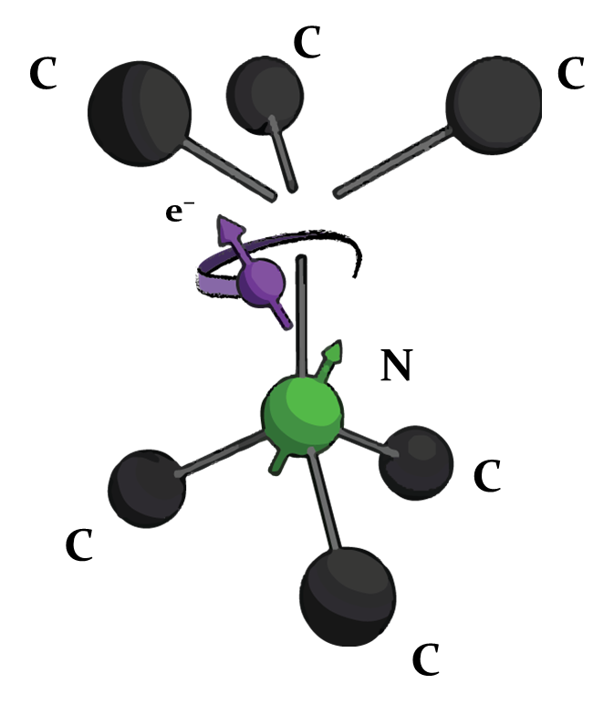

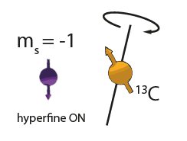
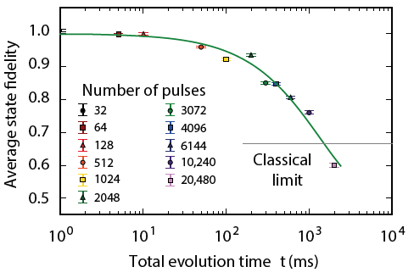
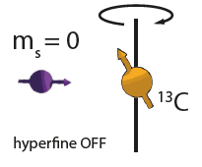
The Nitrogen Vacancy Centre in Diamond
C¹³
M. H. Abobeih et al. Nature Comm. 2018.
C¹³

Slide 6
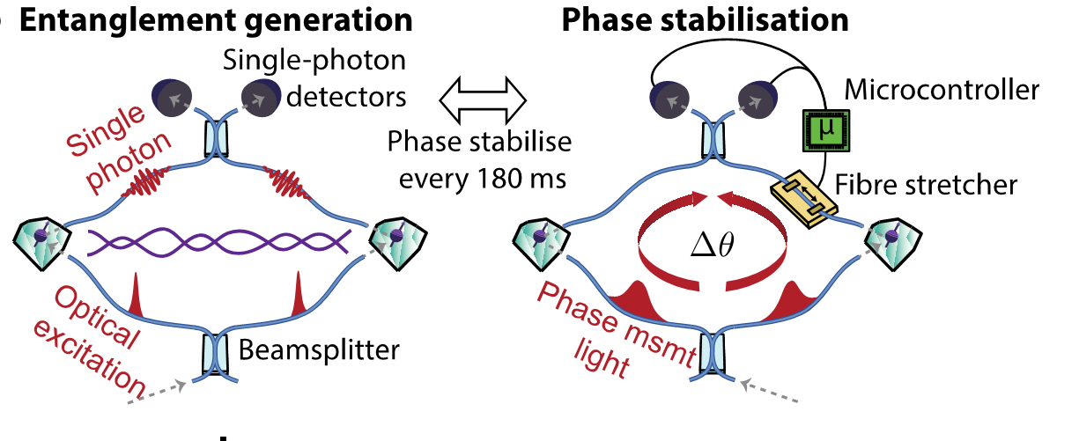
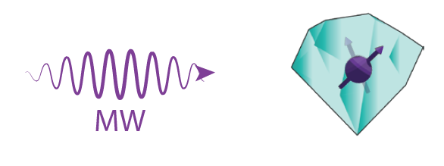

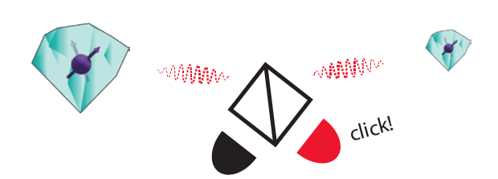
Single Click Entanglement
P C Humphreys et al., Nature 558, 268–273 (2018)

Slide 7
Research goals
Demonstration of quantum applications on a multi-node network
Generation of genuine multipartite entangled states,
Proof of principle demonstration of the Link layer of the future Quantum Internet stack,
Teleportation of entanglement in a four node network,
Client-Server secure delegation of quantum computation.

Slide 8
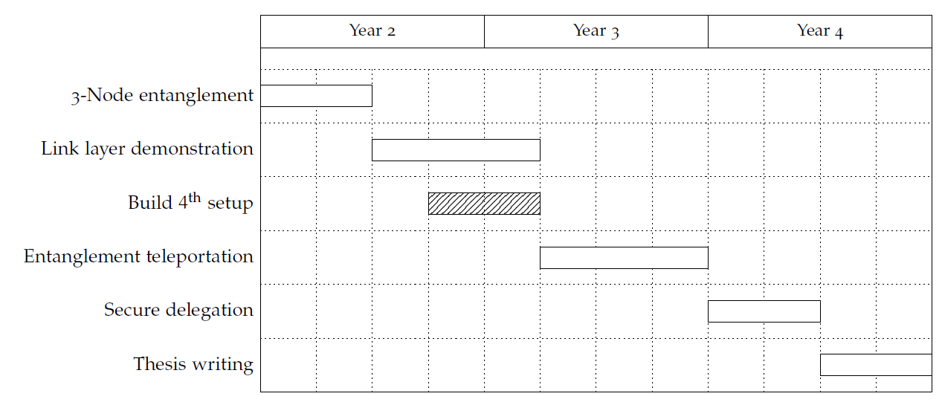
Proposed Ph.D. Timeline

Slide 9
Genuine Multipartite Entanglement
During first year:
Built third node (LT5)
Tested improvements for all setups:
Faster microprocessor
Fibre based laser control
Improved control of laser pulses
Faster phase stabilisation

Slide 10
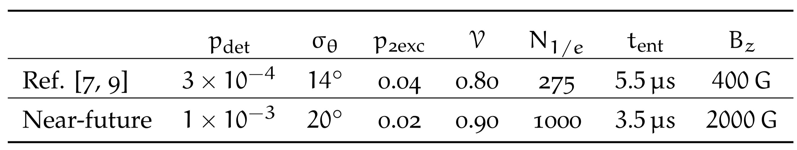
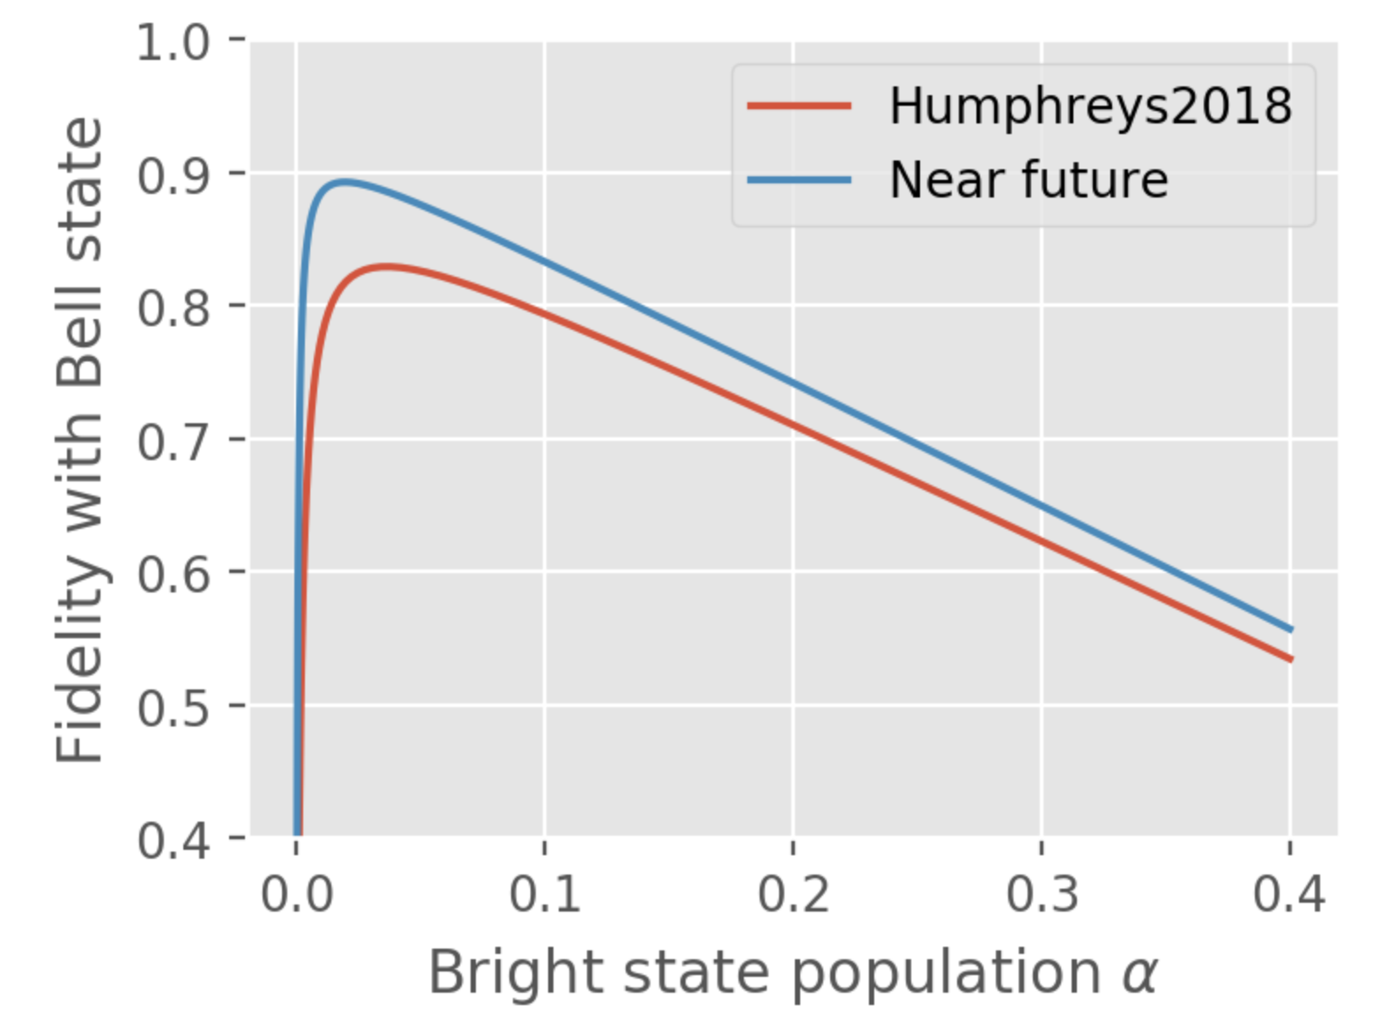
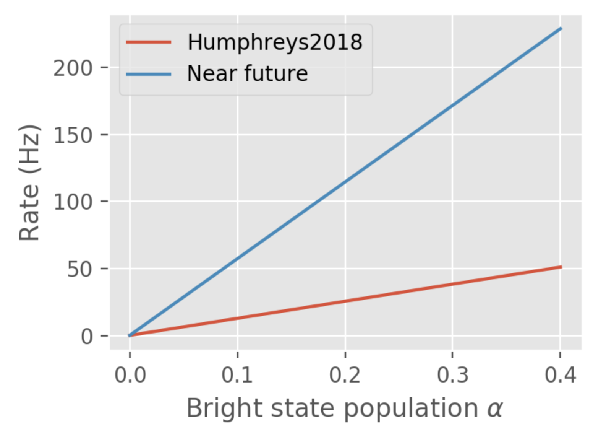
Genuine Multipartite Entanglement

Slide 11
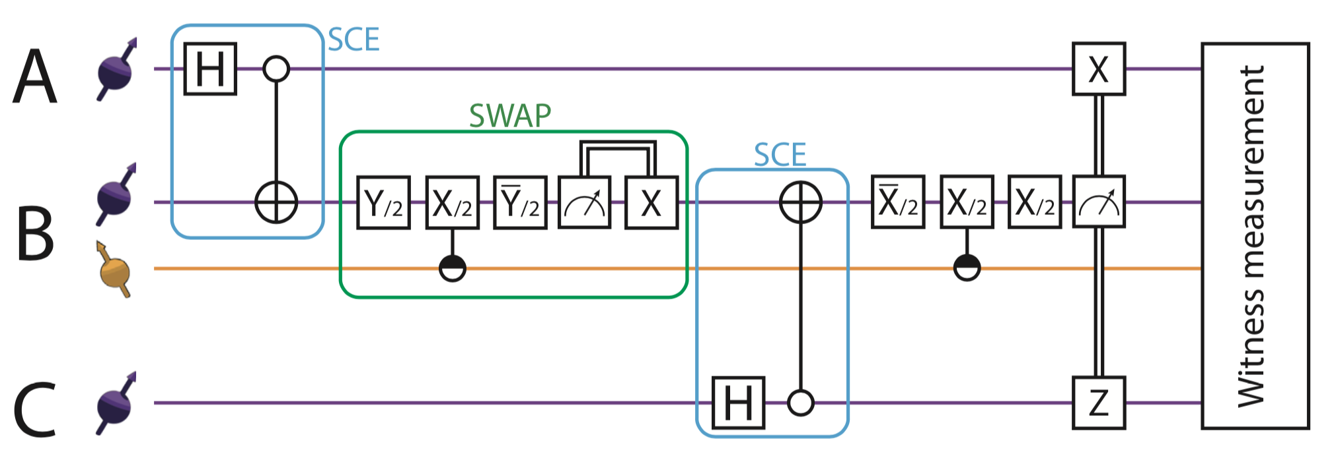
Genuine Multipartite Entanglement

Slide 12
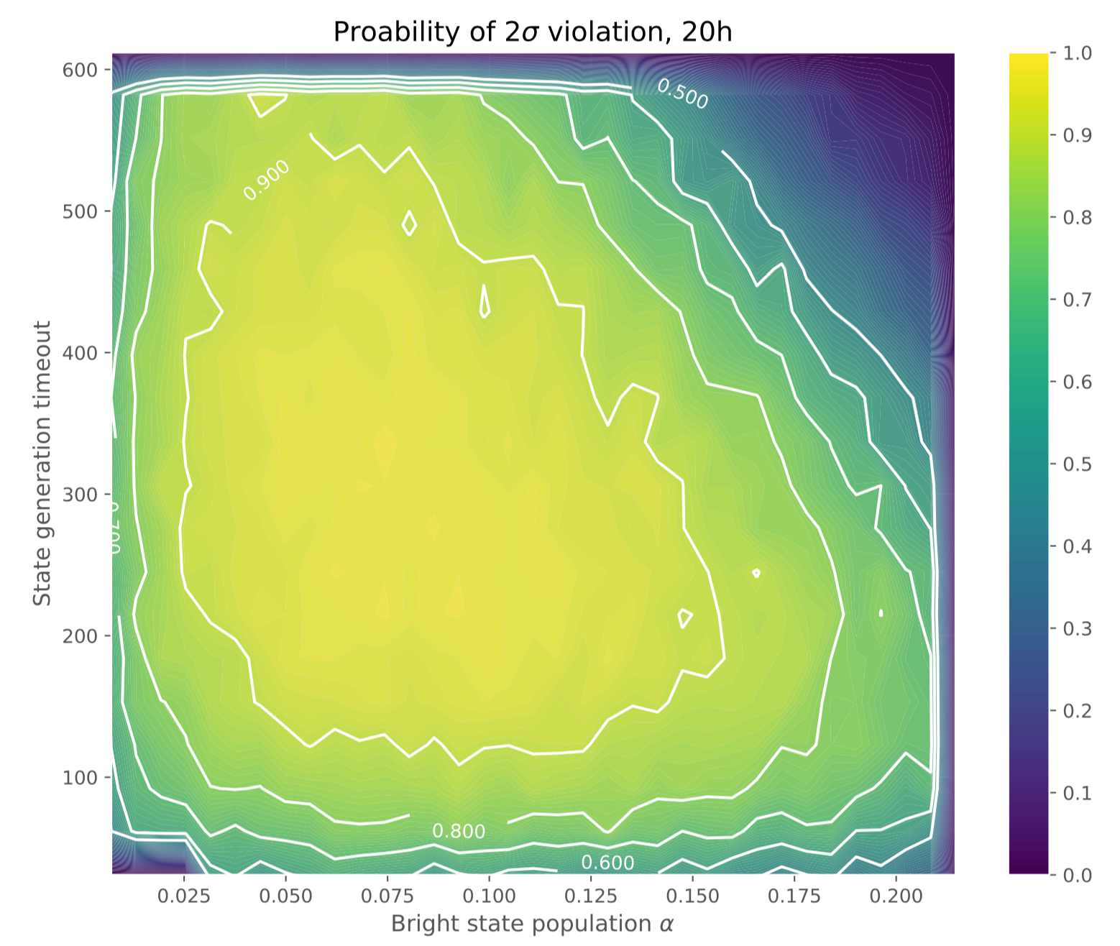
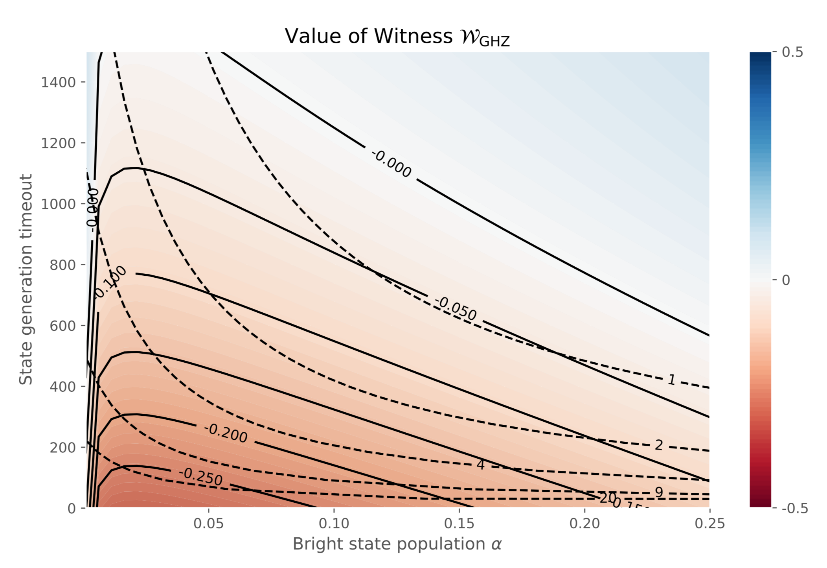
Genuine Multipartite Entanglement

Slide 13
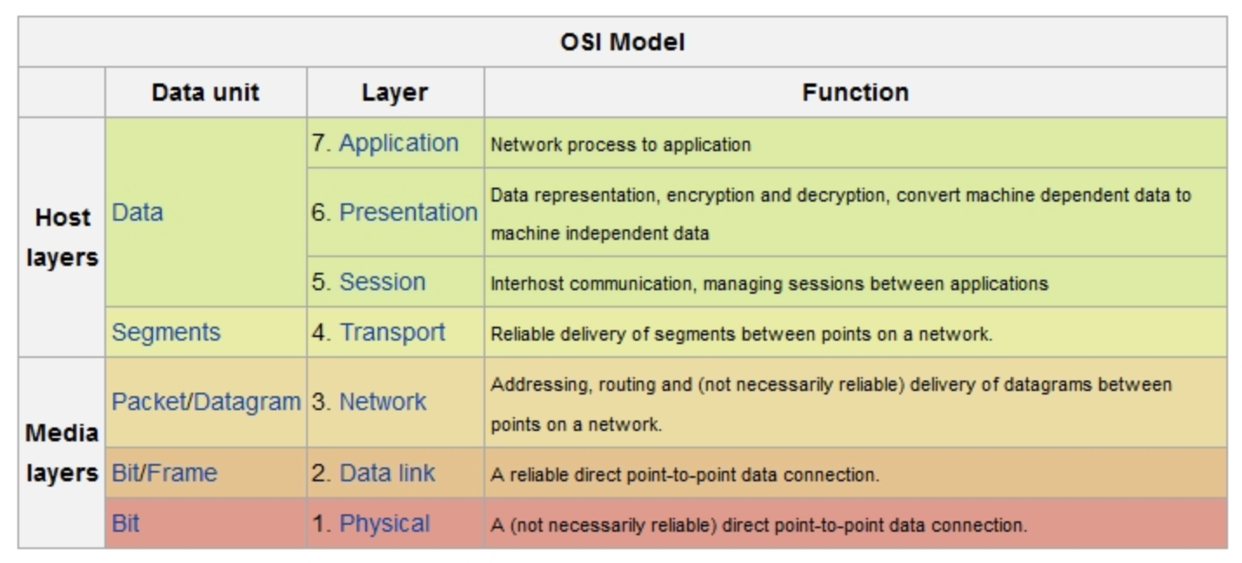
Link Layer Demonstration
This is the final target
Next step
We are here

Slide 14
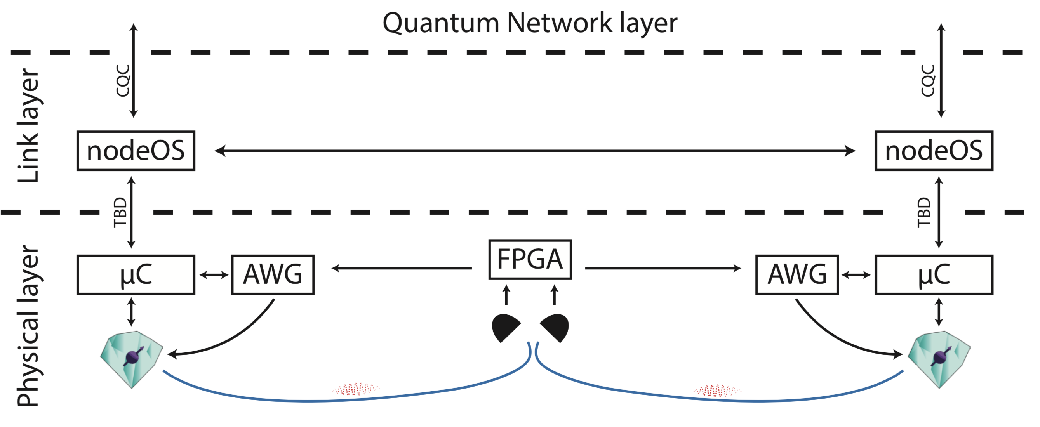
Link Layer Demonstration

Slide 15
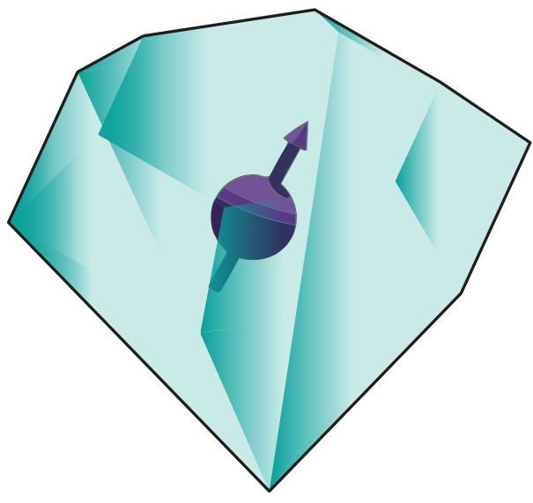
Teleportation of Entanglement

Slide 16
Teleportation of Entanglement
Main challenges:
Build a 4th setup
Run 4 nodes at the same time

Slide 17
Client-Server Secure Delegation
Send N random qubits
Client
O(1) qubits
Server
N qubits
Tell measurements to run
Report results
- Result of computation only known to Client
- Detail of the computation only known to Client
- Client can check if Server is truly quantum

Slide 18

Client-Server Secure Delegation
Client
Teleport
Teleport
Teleport
Server
U₁
Z
U₂
Z
U₃

Slide 19
Client-Server Secure Delegation
Main challenges:
Increase number of memory qubits
While increasing their lifetime
Adaptive operations / measurement

Slide 20
Proposed Ph.D. Timeline

Slide 21
Thanks!

